Slide 1
Module 2 – Control Statements
Notes:
When listing all project collaborators, either use commas or bullets

Slide 2
Control Statements
If - else
If-else-if
Nested if
Switch
Notes:
What is the name of your colony song?
Write lyrics to the song and, if you are feeling creative, use a computer program or instruments to create the music that goes along with it!
To insert an audio file, click on Recording -> Audio -> Audio on My PC and choose your file

Slide 3
If - Else Statement
If - else : SYNTAX
if (Condition) {
Statement1;
}
else{
Statement2;
}
If Condition is ‘true’ then Statement1 is executed else Statement2 is executed

Slide 4
If - Else - if
if - else - if : SYNTAX
if (Condition1) {
Statement1;
}
else if(Condition2) {
Statement2;
}
….
…
else {
Statement;
}

Slide 5
Nested - if
Nested - if : SYNTAX
if (Condition1) {
if (Condition2) {
Statement 1;
}
else {
Statement 2;
}
}
else {
Statement 3;
}

Slide 6
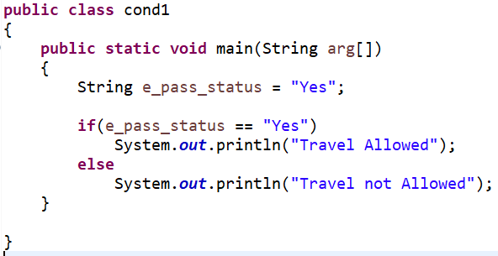
If – else
If – else : Example

Slide 7
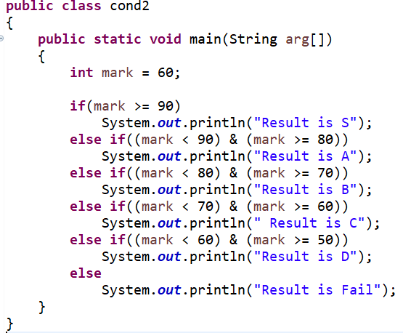
If - Else - if
If – else – if : Example
Result is C

Slide 8
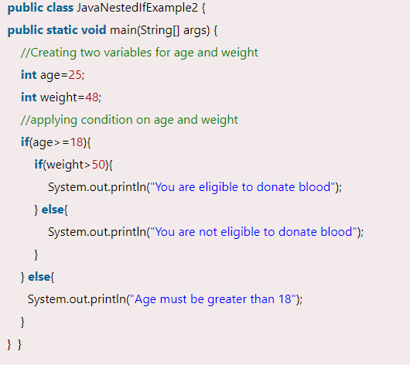
Nested - if
Nested – if : Example

Slide 9
Feature | & (Bitwise/Logical AND) | && (Logical AND with Short-Circuiting)
Type | Bitwise (for integers) or logical (for Booleans) | Logical (for Booleans only)
Short-Circuiting | No | Yes
Evaluation | Always evaluates both sides | Stops evaluating if the first operand is false
Operands | Works on integers and Booleans | Works only on Booleans

Slide 10
Feature | | (Bitwise/Logical OR) | || (Logical OR with Short-Circuiting)
Type | Bitwise (for integers) or logical (for Booleans) | Logical (for Booleans only)
Short-Circuiting | No | Yes
Evaluation | Always evaluates both sides | Stops evaluating if the first operand is true
Operands | Works on integers and Booleans | Works only on Booleans

Slide 11
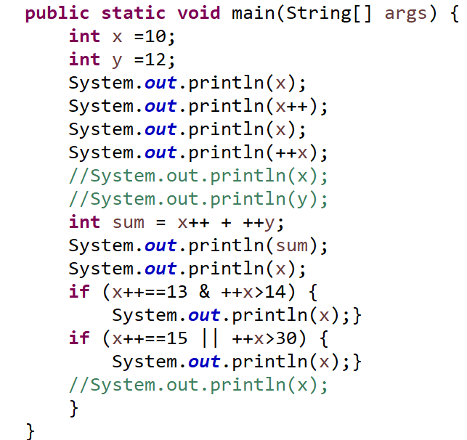

OUTPUT:

Slide 12
Solve
TASK
Write a java program to find whether a year is a leap year or not.
Write a java program to check whether a number is divisible by 5 and 11 or not.
Write a java program to input any character and check whether it is a vowel or consonant

Slide 13
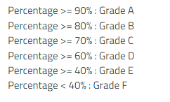
Solve
4. Write a java program to get marks of 5 subjects Calculus, Maths, Basic Electronics, Java and English. Calculate the percentage and grade according to the following:

Slide 14
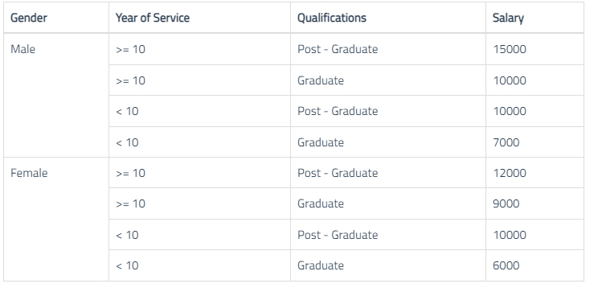
Solve
5. Write a java program to calculate the salary as per the following table

Slide 15

Solve
6. Write a java program to take 4 inputs from the user and check whether they are in increasing or decreasing order.
7. Ram, Rohan and Rehan are friends. Write a java program to find the youngest of 3.
8. Write a java program to input the basic salary of an employee and calculate its Gross salary according to the following

Slide 16
CONTROL STATEMENTS
CONTROL STATEMENTS
Switch
Nested Switch

Slide 17
SWITCH
Is used to test the equality of a variable against several values specified in the test cases.
The switch statement begins with the keyword switch followed by an integral expression in parentheses and called the controlling expression
The action for each case typically ends with the word break.
The break statement prevents the consideration of other cases.

Slide 18
Switch - syntax
switch (Expression)
{
case value1:
//statements;
break;
.
.
default
//statements
}

Slide 19
Each case consists of the keyword case followed by
a constant called the case label
a colon
a list of statements.
The list is searched for a case label matching the controlling expression.
The action associated with a matching case label is executed.
If no match is found, the case labelled default is executed.
The default case is optional but recommended, even if it simply prints a message.
Repeated case labels are not allowed.

Slide 20
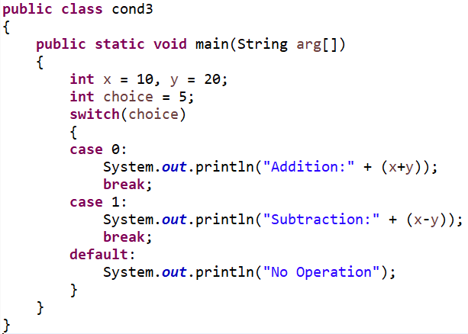
Switch – Example
OUTPUT:
No Operation

Slide 21
Nested switch - syntax
switch (Expression)
{
case value1:
switch (Expression2)
{
// Switch Block
}
.
.
default
//statements
}

Slide 22
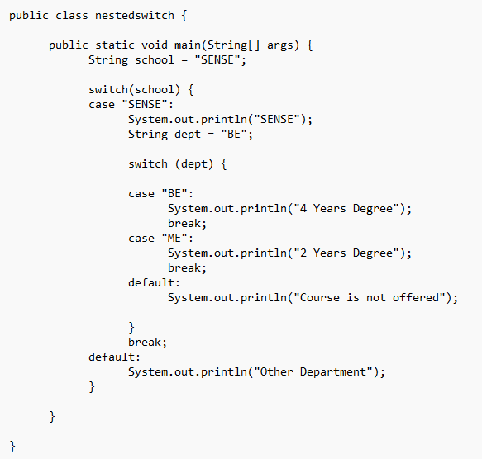
Nested switch - example
OUTPUT:
SENSE
4 Years Degree

Slide 23
TASK
Write a java program to display the name of the day based on the given value using the switch statement. Have default statement as “invalid”.
1 | Monday
2 | Tuesday
3 | Wednesday
4 | Thursday
5 | Friday
6 | Saturday
7 | Sunday

Slide 24
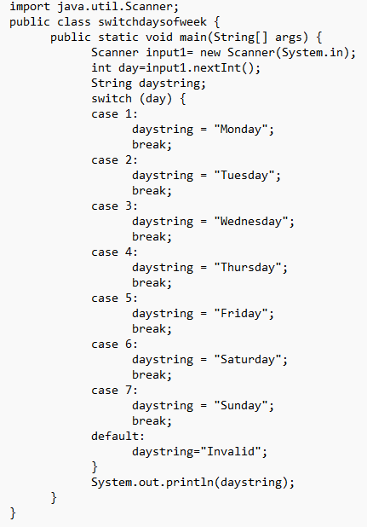
Solution

Slide 26
